Slide 1
GYM TRAINER AND PROGRESS TRACKER APPLICATION
Name: GIRISHKANTH d Roll no: 727822tucs037 team no: 13

Slide 2
Objective
The objective of the FitClub Tracker Analyzer project is to develop a comprehensive web application designed to enhance fitness management for users and administrators.
The application aims to streamline the process of logging workouts, monitoring progress, and managing fitness metrics, making it easier for users to track their fitness journey.
For administrators, the project focuses on providing robust tools for managing user profiles, workout details, and progress logs, ensuring effective data oversight and management.
Additionally, the application will incorporate secure authentication mechanisms using JWT (JSON Web Tokens) to protect user data and restrict access to sensitive information, thereby maintaining a high level of security and reliability.

Slide 3
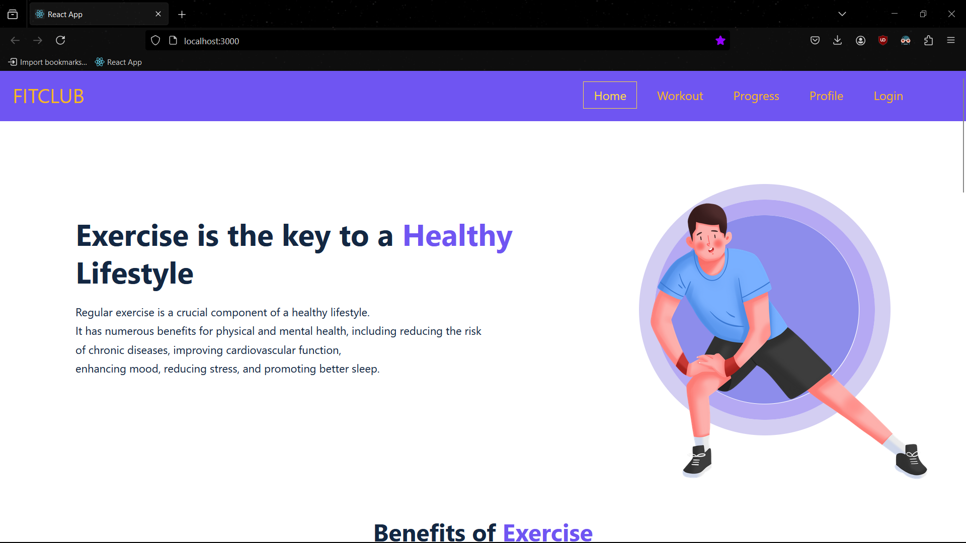
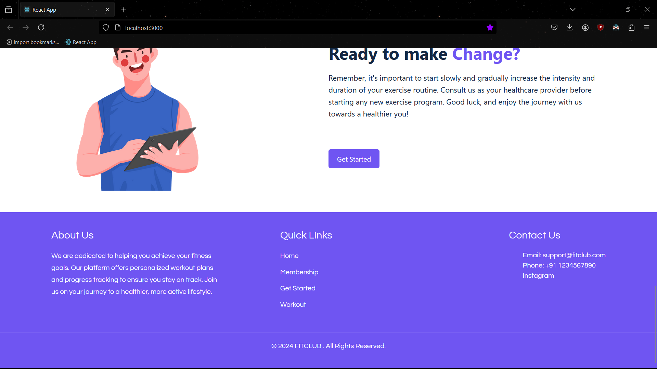
Front End layout

Slide 4
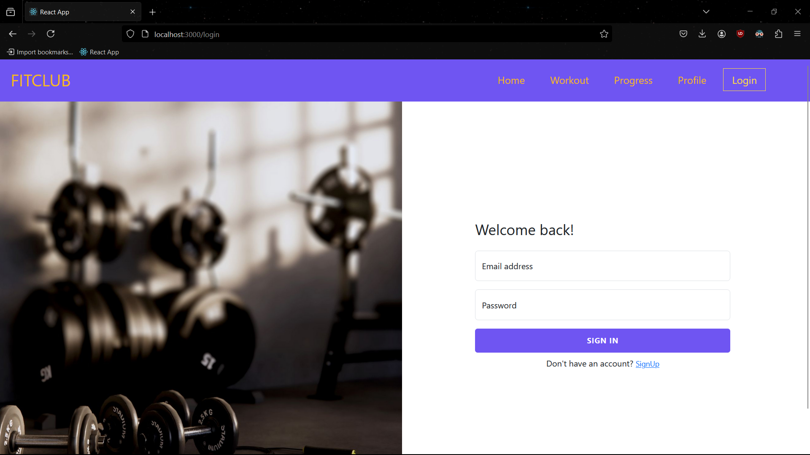
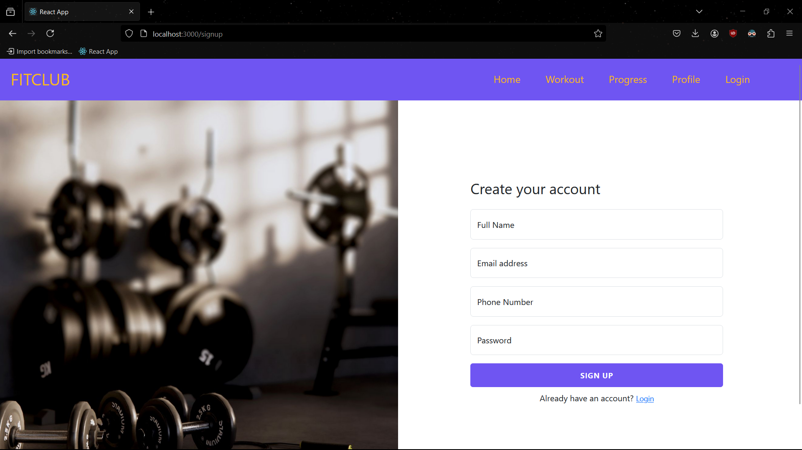
Front End layout

Slide 5
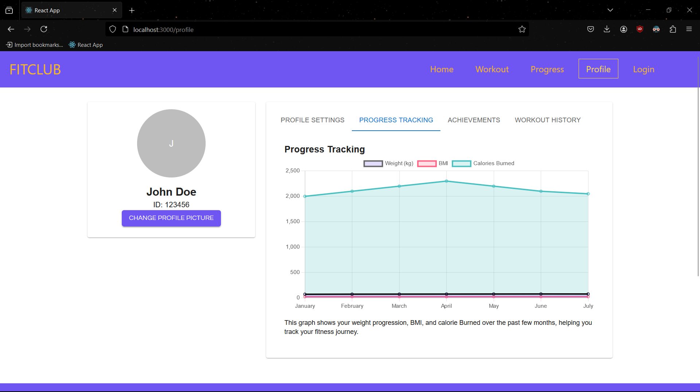
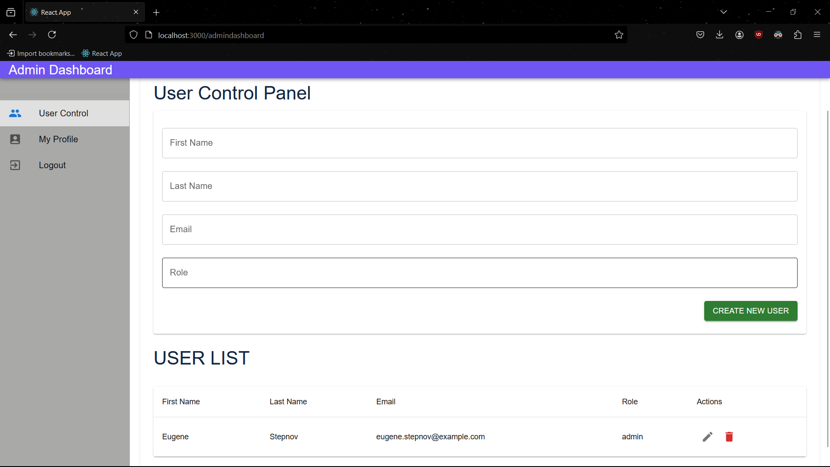
Front End layout

Slide 6
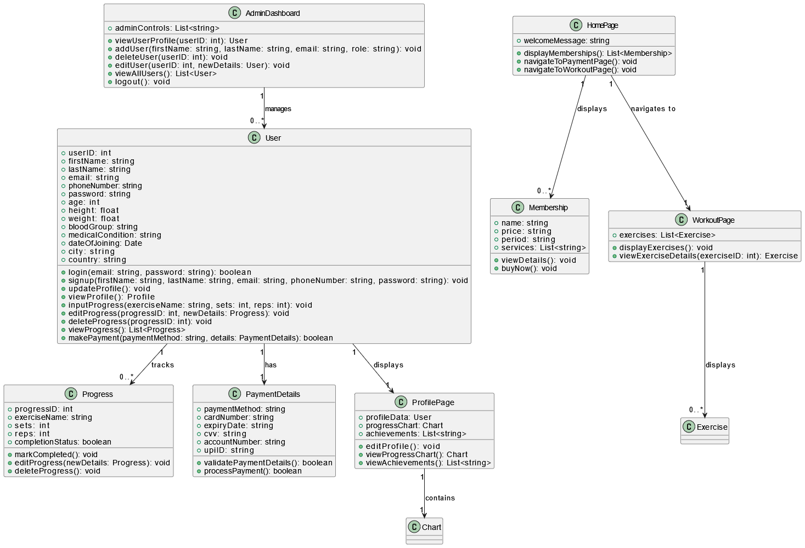
Class diagram

Slide 7
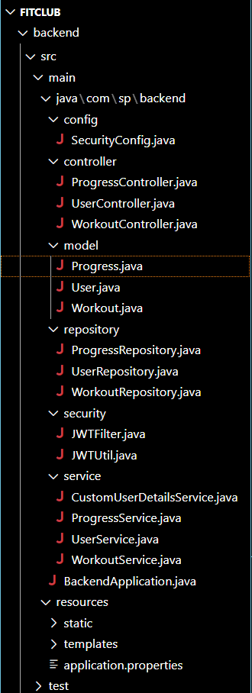
BACK END LAYOUT
ENTITIES: User Progress Workout

Slide 8
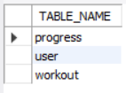
DATABASE TABLE LAYOUT
User Table Stores user information for authentication and profile management.
Progress Table: Tracks individual workout sessions and user progress over time.
Workout Table: ontains information about different workout routines and exercises

Slide 9
RELATIONSHIP MAPPING
ONE TO MANY MAPPING: USER TO PROGRESS ADMIN TO USER

Slide 10
THANK YOU

